Slide 1
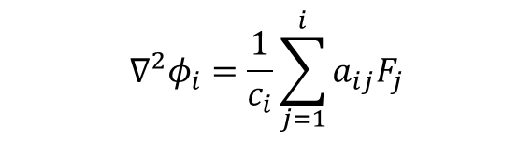


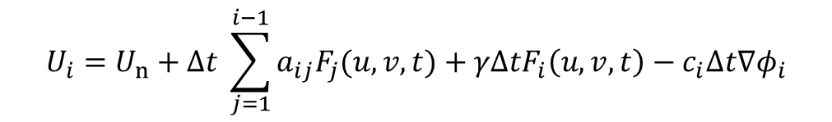
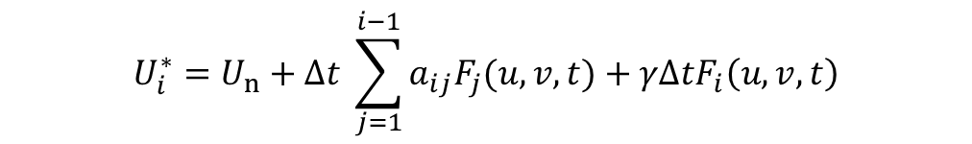



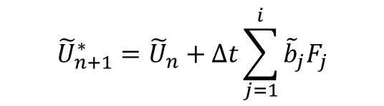


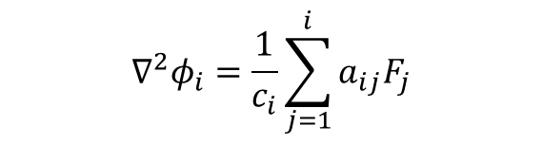

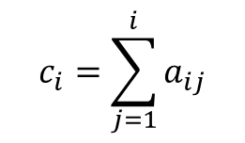

Implicit Formulation of Projection Method
General Runge-Kutta stage $i$:
$$c_{i}=\sum_{j=1}^{i}{a_{ij}}$$
$$U_{i}=U_{n}+Δt \sum_{j=1}^{i−1}{{a_{ij}F}_{j}(u,v,t)}+γΔtF_{i}\left(u,v,t\right)−c_{i}Δt∇φ_{i}$$
$$∇^{2}φ_{i}=\frac{1}{c_{i}}\sum_{j=1}^{i}{a_{ij}F_{j}}$$
Where $φ_{i}$ is the pressure-like Lagrange multiplier which satisfies the divergence-free criteria from
For each stage $i$:
$$U_{i}^{∗}=U_{n}+Δt \sum_{j=1}^{i−1}{{a_{ij}F}_{j}(u,v,t)}+γΔtF_{i}\left(u,v,t\right)$$
Solve tentative velocity :
$$∇^{2}φ_{i}=\frac{1}{c_{i}}\sum_{j=1}^{i}{a_{ij}F_{j}}$$
Solve Poisson correction:
Projection onto the space of divergence free velocity fields
Update velocity:
$$U_{i}=U_{i}^{∗}−c_{i}Δt ∇φ_{i}$$
Store stage derivative:
$$F_{i}(U_{i})$$
$$∇^{2}φ_{n+1}=\sum_{j=1}^{s}{b_{j}F_{j}}$$
If $b_{i}=a_{si}$ i.e. stiffly accurate then
Last stage:
$$U_{n+1}=U_{n+1}^{∗}−Δt ∇φ_{n+1}$$
$$U_{s}=U_{n+1}$$
$${\tilde{U}}_{n+1}^{∗}={\tilde{U}}_{n}+Δt\sum_{j=1}^{i}{{\tilde{b}}_{j}F_{j}}$$
$$∇^{2}{\tilde{φ}}_{n+1}=\sum_{j=1}^{s}{{\tilde{b}}_{j}F_{j}}$$
Embedded method:
$${\tilde{U}}_{n+1}={\tilde{U}}_{n+1}^{∗}−Δt ∇{\tilde{φ}}_{n+1}$$
* Energy-conserving Runge-Kutta methods for the incompressible Navier-Stokes equations, B. Sanderse (2012)

